Slide 1

13th September 2024
leighanna.ofarrell@stockport.gov.uk and password: Stockport123!
Stockport MDC Board update
Digitally enabled places:
Innovation Deep Dive

Slide 2

2
Innovation Deep Dive update
Context
The MDC commissioned WSP to help us develop an overarching approach to digital innovation.
Innovation as a Core Principle: Since 2019, innovation has been central to MDC's strategy
Strategic Focus: Vision for Town Centre West as a ‘digitally enabled neighbourhood’
A testbed for innovation: Town Centre West is positioned as a leader in adopting new approaches to town centre living, ensuring long-term relevance.

Slide 3

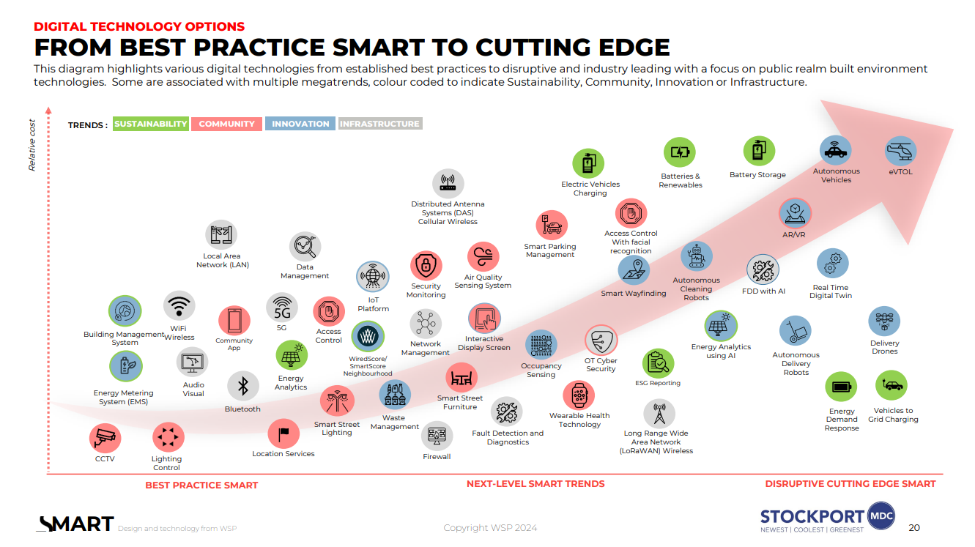
WSP Recommendations
13th September 2024

Slide 4
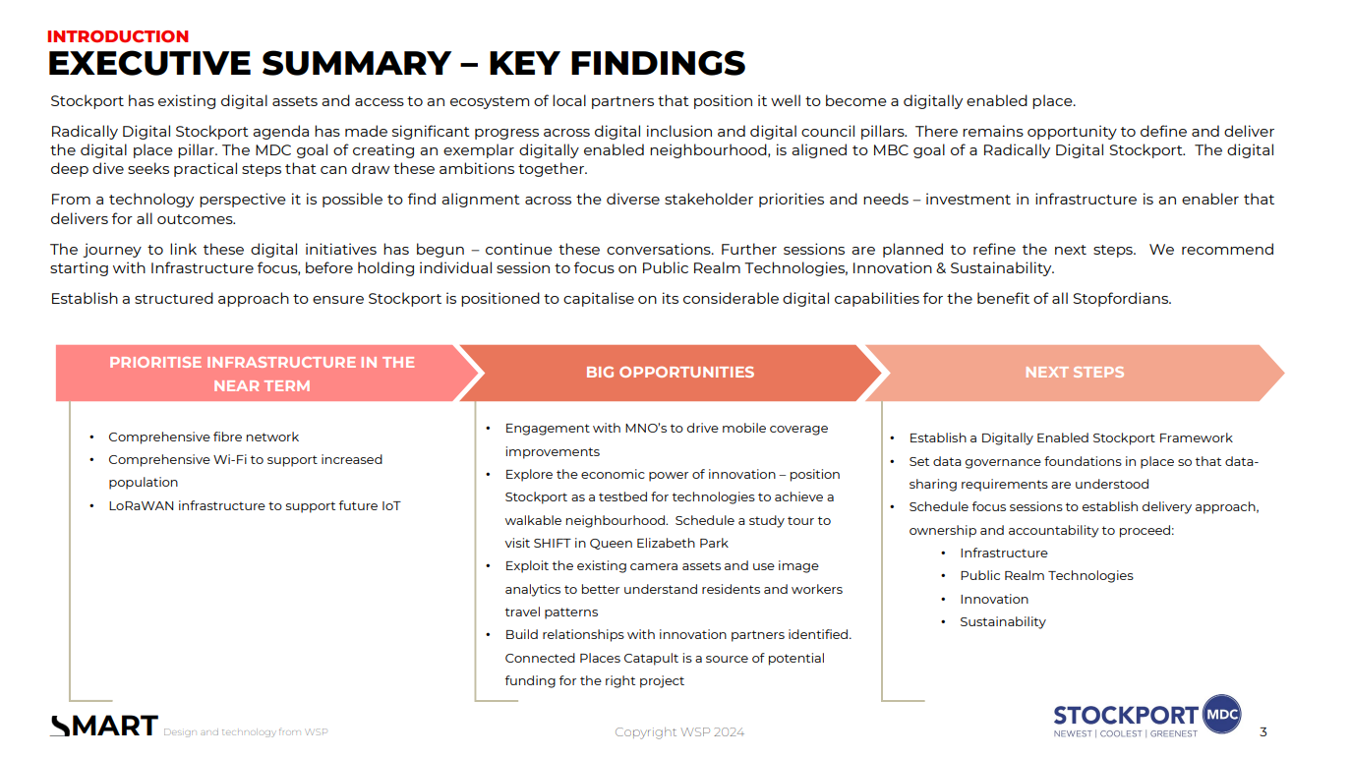

Slide 5
Proposed next steps
13th September 2024

Slide 6
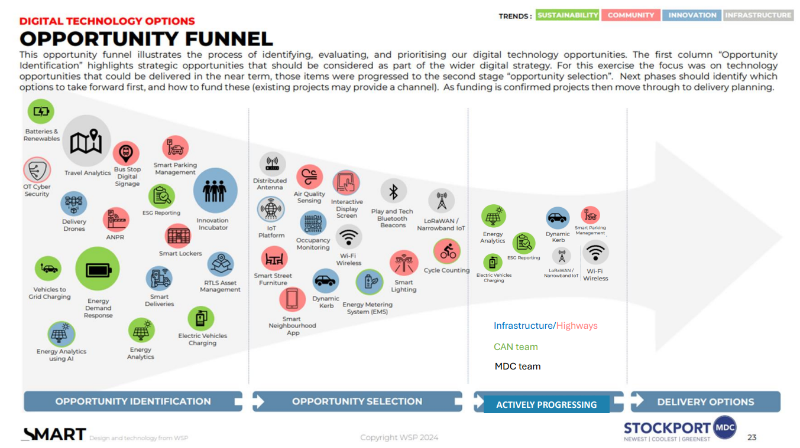

Slide 7
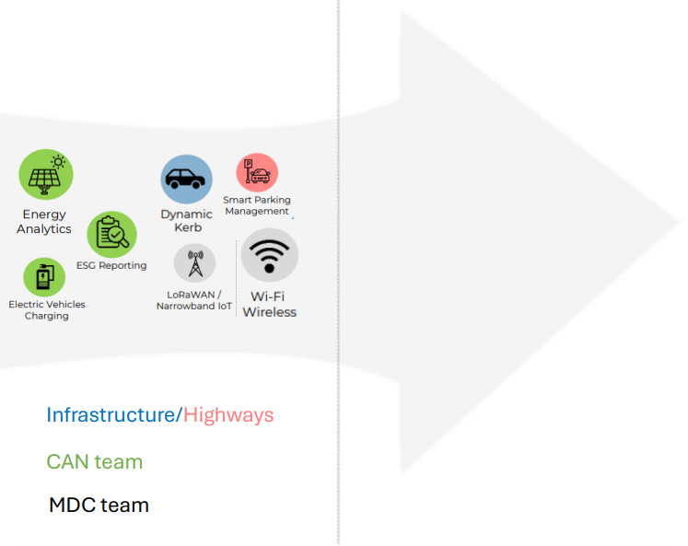
7
Innovation Deep Dive update
Progressing Innovation.
The next step is for the lead teams to explore funding and delivery opportunities for the suggested technologies and applications in the opportunity funnel.

Slide 8
8
Innovation Deep Dive update
Progressing Innovation.
Climate Action Now (CAN) Team | MDC Team | SMBC Highways/Infrastructure Team
Energy analytics | Mobile network operator (MNO) engagement | Smart parking management
ESG reporting | Expansion of public Wifi | Dynamic kerb
Electric vehicle charging | Expansion of LoRaWAN | Explore existing camera assets in the borough
Explore economic power of innovation, positioning Stockport as a testbed for technologies that support modal shift Explore data governance foundations so that data sharing requirements are understood Explore potential for a Digitally Enabled Stockport framework

